Slide 1

Prayaas
An Initiative by students of Jayshree Periwal International School
Interaction with representatives of Hotel Industry of Jaipur - Date 25th January, 2025.

Slide 2
An Introduction to Prayaas
01
03
Prayaas is an initiative that traces its origin to 3rd December 2024, the occasion of International Day for Persons with Special Abilities.
Disability is not something one is always born with, it can happen at any stage of life.
02
04
Aim of Prayaas initiative is to ensure that everyone gets a chance to earn a respectable livelihood.
There is a growing concern worldwide for more inclusion in all aspects of human life.

Slide 3
Livelihood - A must for every person
In order to have a lead a respectful life, Roti, Kapda aur Makaan is imperative to every individual
Need for skilling for all
Special focus should be on Persons with Special needs as the challenges they deal with are more.

Slide 4
Role of Hospitality Industry
In the modern world, hospitality sector plays a key role. It’s a major employer. It has a secure and encouraging environment for persons with special needs. Some examples are already there. Sharing in the following slides-

Slide 5
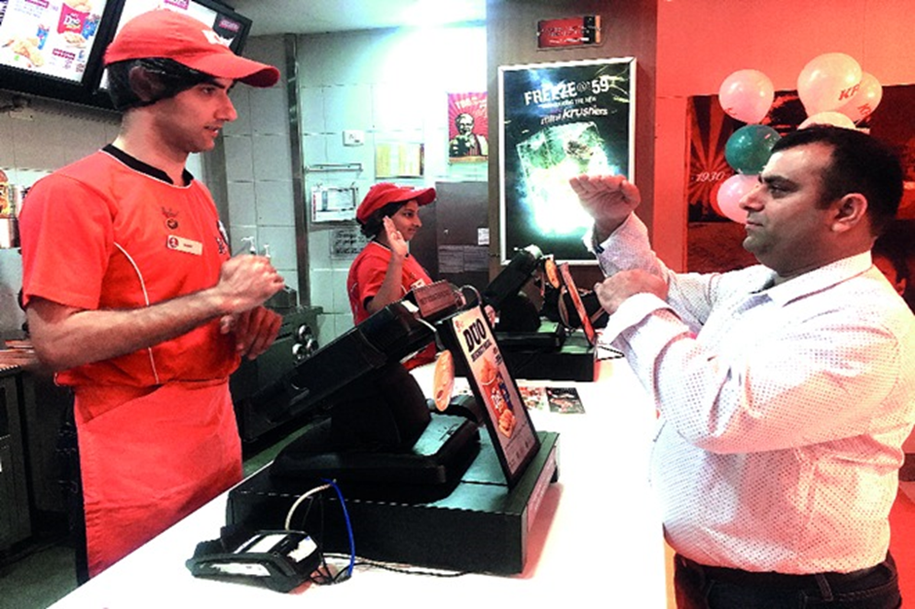
Kentucky Fried Chicken
KFC conducts hearing and speech impaired training projects and employees 170 specially-abled employees across 20 stores in India. The company started the KFC Academy to develop skills which increase employability not only in KFC but across all retail food chains. The fully sponsored 11-week (60 hours) training program teaches young, hearing-impaired differently abled English, Critical Skills, realistic job preview, food safety, industry familiarisation, life skills and grooming.

Slide 6
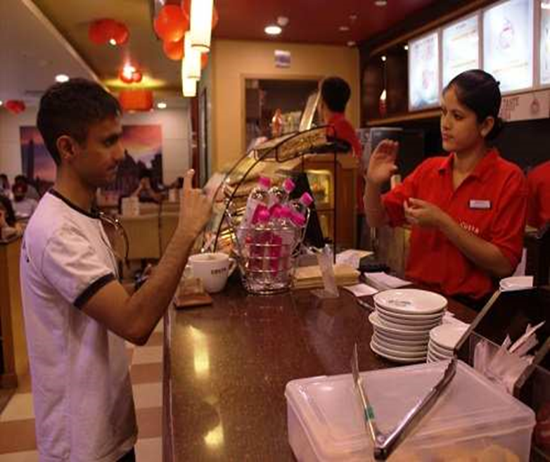
Costa Coffee
The Coffee Shop chain overall employs around 100 (15% of store employee base) and is planning at increasing the number of PwDs and hiring them gradually across all stores. One novelty about the chain is that its outlet in Green Park, Delhi is completely run by PwDs.

Slide 7
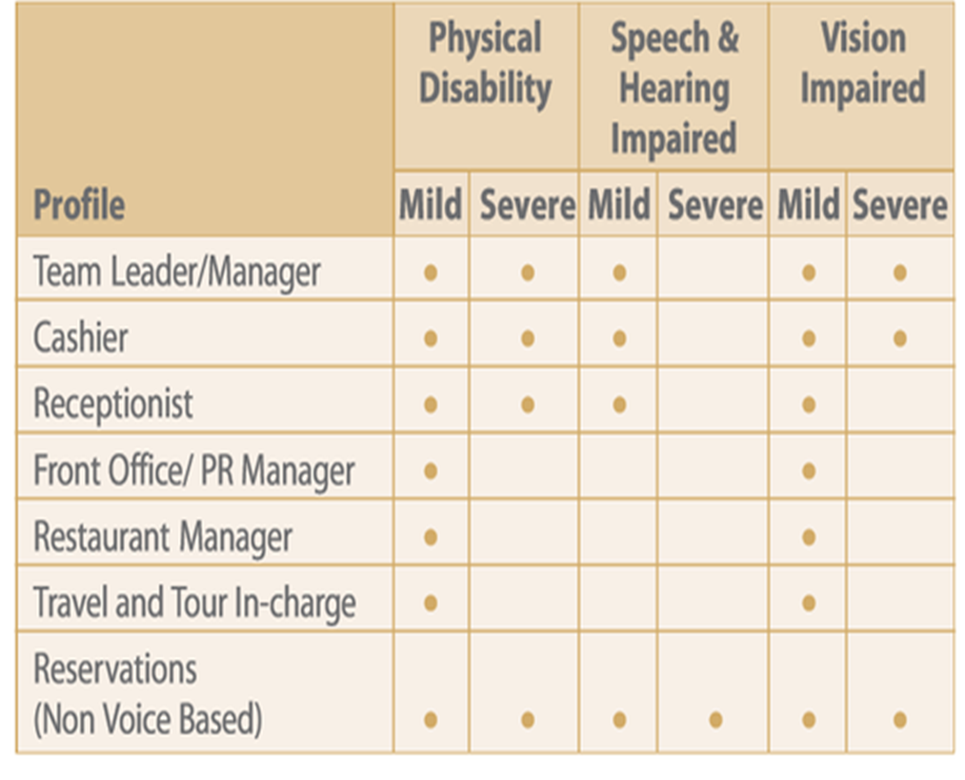
ITC Hotels
The hotel chain ITC employees many PwDs in its hotels around India. Depending on the kind and severity of their disability, individuals are provided with roles that suit them.

Slide 8
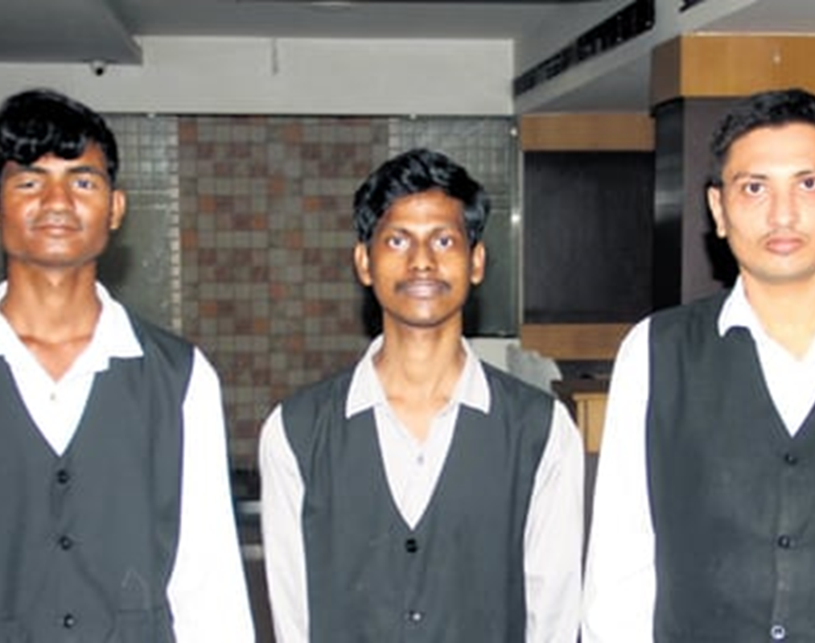
Hotel Winsar Park
: In a world where individuals with disabilities often face hurdles to employment and societal misconceptions, Hotel Winsar Park in Visakhapatnam stands as a beacon of inclusivity and empowerment. Within its walls, the success stories of Prakash, Durga Prasad, Parvathi Durga Prasad and Naidu, all aged below 30, have unfolded, showcasing the hotel’s commitment to providing equal opportunities to all and breaking stereotypes

Slide 9
Advantages of hiring PWDs
01
02
03
Very humble and compassionate by nature
Very punctual and focused
Customer connect and satisfaction

Slide 10
Thank you !
And looking forward to growing up in a more inclusive world.

